Slide 1
Market Basket Analysis

Slide 2
MBA: Basic Measures
Average number of orders per customer
Average number of unique items per order
Proportion of customers and average purchase size of customers who purchase the most/least popular products
Average order size
By?
Notes:
geography, method of payment, time of year

Slide 3
Market Basket Analysis (MBA)
Items purchased on a credit card, such as rental cars & hotel rooms, provide insight into next product customers are likely to purchase,
Optional services purchased by telecom customers (call waiting, call forwarding, DSL, speed call, etc.) help determine how to bundle services
Banking products used by retail customers (money market accounts, certificate of deposit, investment services, car loans, and so on) identify customers likely to want other products.
Unusual combinations of insurance claims can be a sign of fraud and can spark further investigation.
Medical patient histories can give indications of likely complications based on certain combinations of treatments.

Slide 4

Association Rule Mining
Given a set of transactions, find rules that will predict the occurrence of an item based on the occurrences of other items in the transaction
Market-Basket transactions
Example of Association Rules
{Diaper} → {Beer},
{Milk, Bread} → {Eggs,Coke},
{Beer, Bread} → {Milk},
Implication means co-occurrence, not causality!

Slide 5

Definition: Frequent Itemset
Itemset
  A collection of one or more items
    Example: {Milk, Bread, Diaper}
  k-itemset
    An itemset that contains k items
Support count (σ)
  Frequency of occurrence of an itemset
Support
  Fraction of transactions that contain an itemset
Frequent Itemset
  An itemset whose support is greater than or equal to a minsup threshold

Slide 6

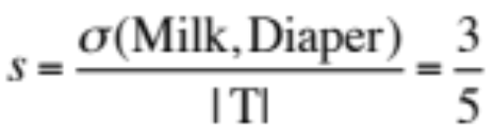
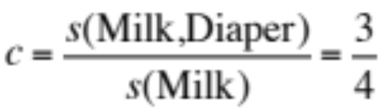
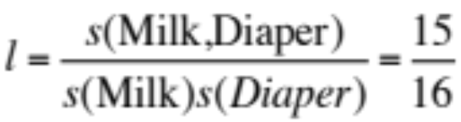
Definition: Association Rule
Association Rule
  An implication expression of the form X → Y, where X and Y are itemsets
Rule Evaluation Metrics
  Support (s)
    Fraction of transactions that contain both X and Y
  Confidence (c)
    Measures how often items in Y
    appear in transactions that
    contain X
  Lift (l)
    the ratio of the observed support to that expected if X and Y were independent.
A lift value less (larger) than 1 indicates a negative (positive) dependence
or substitution (complementary) effect.

Slide 7

Definition: Association Rule
Association Rule
  An implication expression of the form X → Y, where X and Y are itemsets
Rule Evaluation Metrics
  Support (s)
    Fraction of transactions that contain both X and Y
  Confidence (c)
    Measures how often items in Y
    appear in transactions that
    contain X
  Lift (l)
    the ratio of the observed support to that expected if X and Y were independent.

Slide 8
Association Rule Mining Task
Given a set of transactions T, the goal of association rule mining is to find all rules having
  support ≥ minsup threshold
  confidence ≥ minconf threshold
Brute-force approach:
  List all possible association rules
  Compute the support and confidence for each rule
  Prune rules that fail the minsup and minconf thresholds
  ⇒ Computationally prohibitive!

Slide 9
Mining Association Rules
Two-step approach:
  Frequent Itemset Generation
    Generate all itemsets whose support ≥ minsup
  Rule Generation
    Generate high confidence rules from each frequent itemset, where each rule is a binary partitioning of a frequent itemset
Frequent itemset generation is still computationally expensive

Slide 10

Frequent Itemset Generation
Given d items, there are 2^{d} possible candidate itemsets

Slide 11

Frequent Itemset Generation
Brute-force approach:
  Each itemset in the lattice is a candidate frequent itemset
  Count the support of each candidate by scanning the database
  Match each transaction against every candidate
  Complexity ~ O(MNw) => Expensive since M = 2^{d} !!!

Slide 12
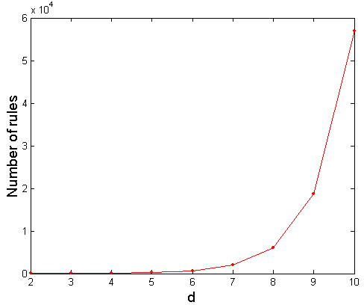
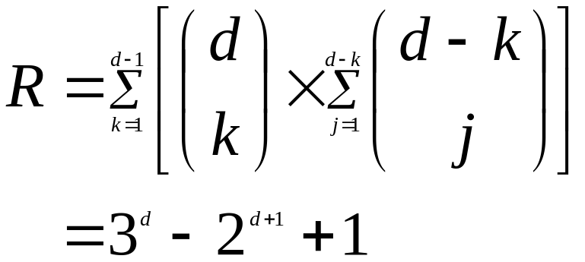
Computational Complexity
Given d unique items:
  Total number of itemsets = 2^{d}
  Total number of possible association rules:
If d=6, R = 602 rules

Slide 13
Mining Association Rules
Example of Rules:
{Milk,Diaper} → {Beer} (s=0.4, c=0.67)
{Milk,Beer} → {Diaper} (s=0.4, c=1.0)
{Diaper,Beer} → {Milk} (s=0.4, c=0.67)
{Beer} → {Milk,Diaper} (s=0.4, c=0.67)
{Diaper} → {Milk,Beer} (s=0.4, c=0.5)
{Milk} → {Diaper,Beer} (s=0.4, c=0.5)
Observations:
All the above rules are binary partitions of the same itemset:
{Milk, Diaper, Beer}
Rules originating from the same itemset have identical support but
can have different confidence
Thus, we may decouple the support and confidence requirements

Slide 14


Found to be Infrequent
Pruned supersets

Slide 15
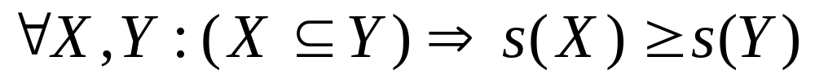
Reducing Number of Candidates
Apriori principle:
  If an itemset is frequent, then all of its subsets must also be frequent
Apriori principle holds due to the following property of the support measure:
  Support of an itemset never exceeds the support of its subsets
  This is known as the anti-monotone property of support

Slide 16
Apriori Algorithm
Method:
  Let k=1
  Generate frequent itemsets of length 1
  Repeat until no new frequent itemsets are identified
    Generate length (k+1) candidate itemsets from length k frequent itemsets
    Prune candidate itemsets containing subsets of length k that are infrequent
    Count the support of each candidate by scanning the DB
    Eliminate candidates that are infrequent, leaving only those that are frequent

Slide 17
Uses of Market Basket Analysis
Online: automated recommendation system, discounts, promotion, placement, cross-selling, etc.
Offline: product placement, supplier management, store design, product catalog design, bundles, discounts, promotions, etc.
Customer Retention: it can be used to create compelling arguments (using, for example, product bundles) to retain customers.

